Slide 1
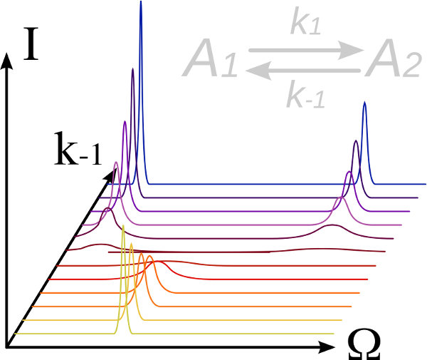
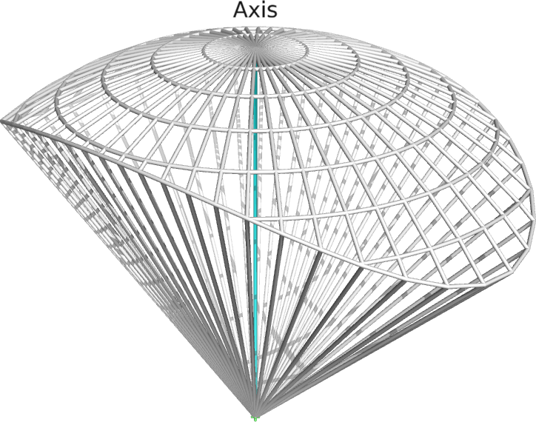
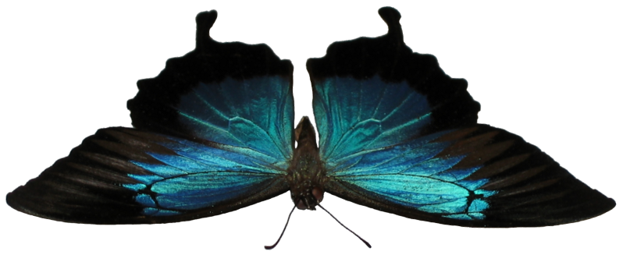
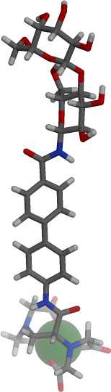
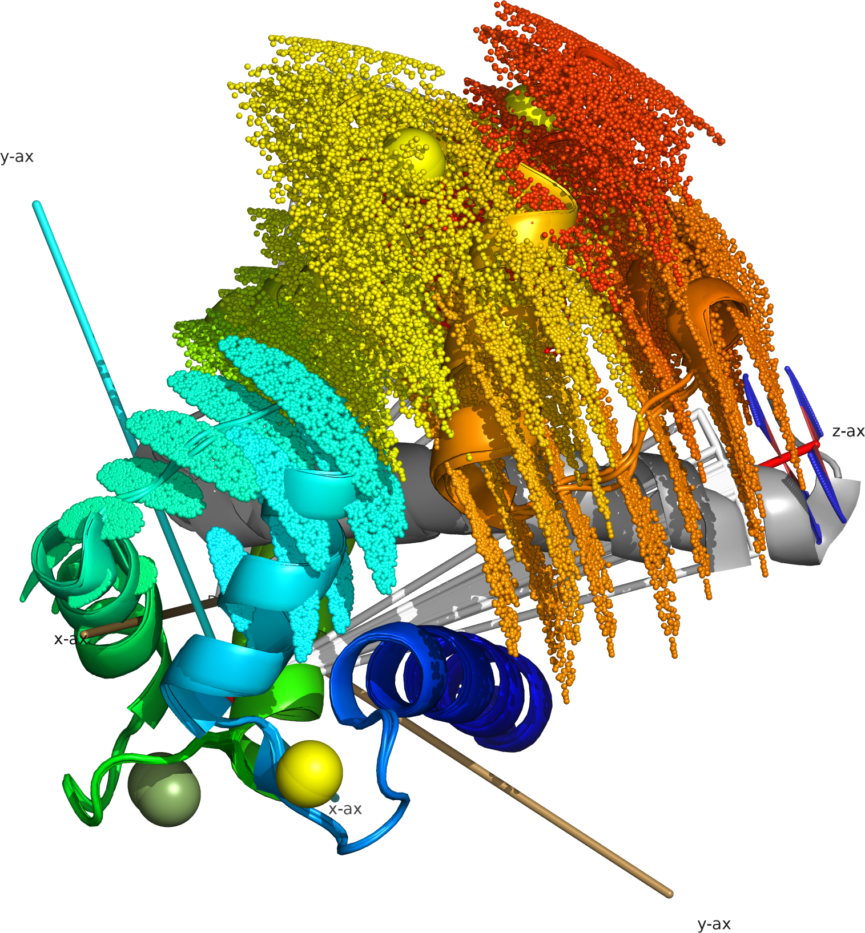
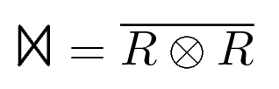
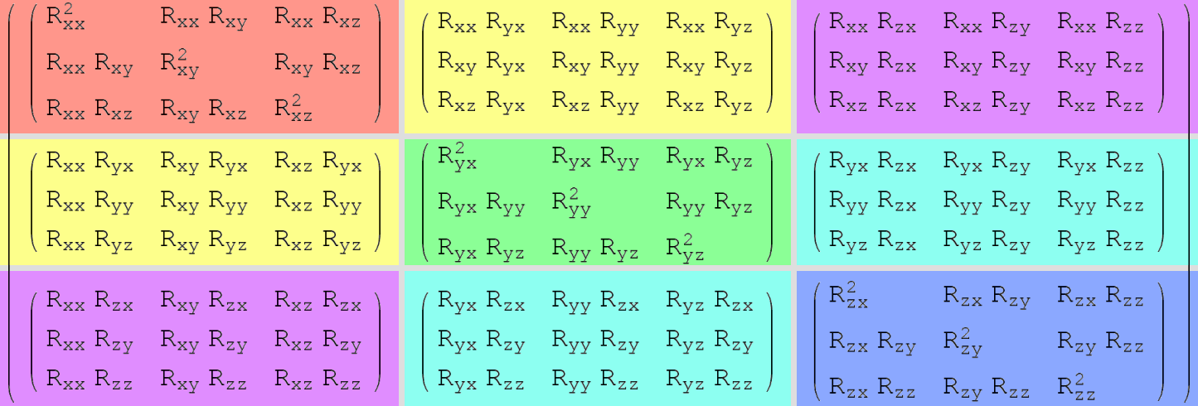
relax – NMR analysis software for molecular dynamics
Edward d'Auvergne

Slide 2
What is the software relax?
For study of molecular dynamics using experimental NMR data.
A collection of tools and algorithms for dynamics data analyses.
Supported analysis types:
R₁ and R₂ exponential curve-fitting.
Steady-state NOE calculation.
Consistency testing of relaxation data.
Reduced spectral density mapping (RSDM).
Model-free analysis.
Relaxation dispersion.
N-state model or ensemble analysis (stereochemistry, conformational analysis, domain motions).
Frame order theory – for domain motions, can model complex motions.

Slide 3
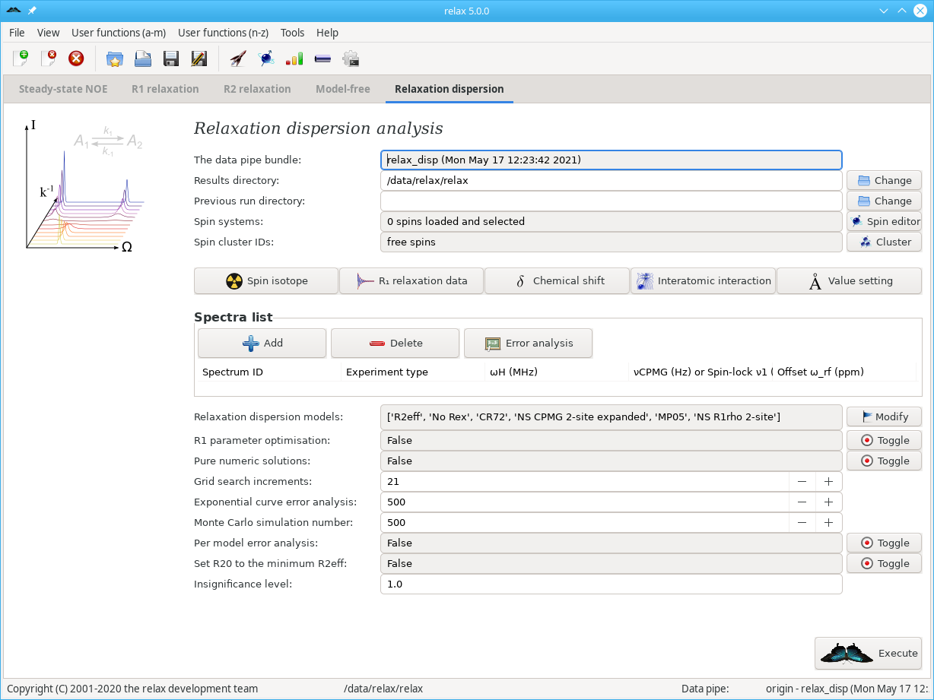

Slide 4
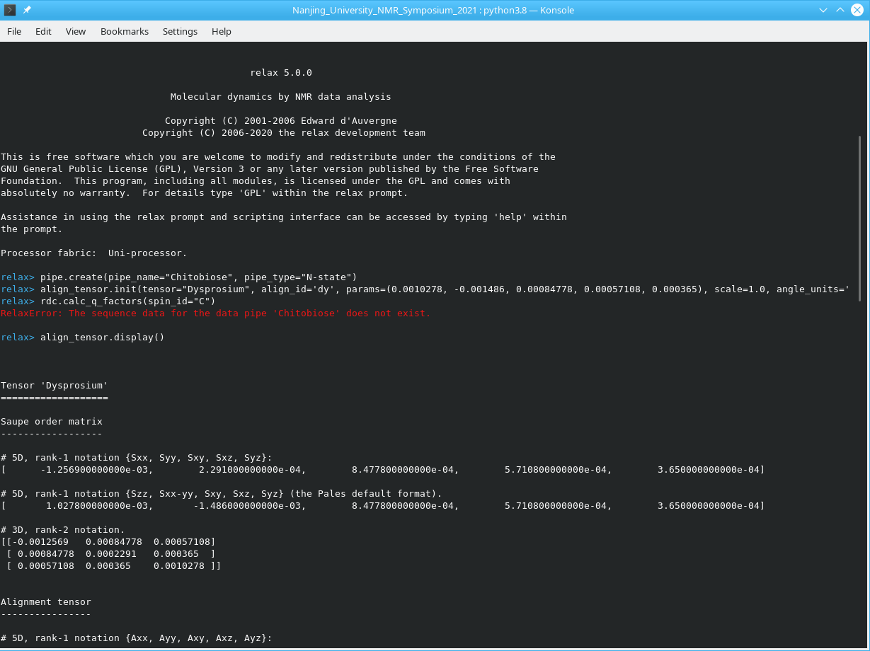

Slide 5
relax’s infrastructure
NMR-specific numerical computation environment – replacement for Mathematica, Maple, Matlab, Maxima, etc.
Comprehensive set of relax library functions:
External packages:
Minfx – large collection of standard minimisation algorithms.
Bmrblib – BioMagResBank NMR-STAR format support.
General library functions:
Rotational diffusion.
Geometry calculations.
Model selection methods.
Interaction with external software.
Sequence alignment.
3D structure manipulation.

Slide 6
relax’s infrastructure
NMR library functions:
Alignment tensors, PCS, RDC.
Auto-relaxation.
Relaxation dispersion models.
Frame order models and functions.
NMR conversions.
Spectral data handling.
Access to Python packages (numpy, scipy, etc.).
100% test suite coverage: Forever guarantees results to be bug-free.
Infrastructure enables new analysis types to be easily added.

Slide 7






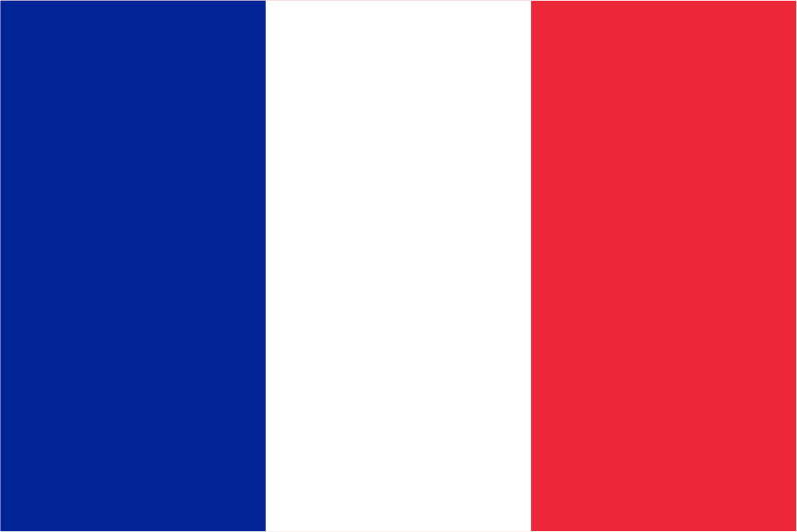



Open source
Contributors from many countries:
Major contributions:
Multi-processor – for running on clusters (Gary Thompson),
Consistency testing of relaxation data (Sébastian Morin),
CST – multi-dipole and rhombic CS (Prof. Fiala's PhD students),
Graphical user interface or GUI (Michael Bieri),
Relaxation dispersion (contributions from 8 different groups),
General improvements (Chris MacRaild, Han Sun, Andrew Perry).
Communication, development, and all infrastructure hosted by SourceForge.

Slide 8
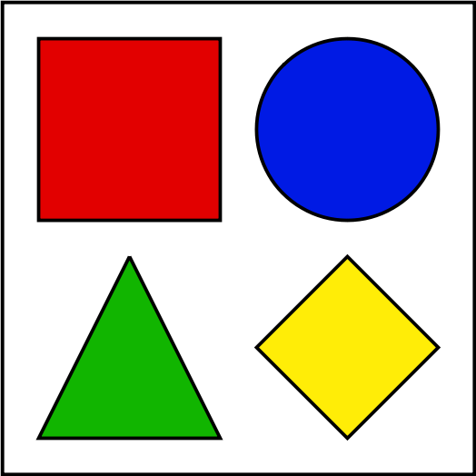
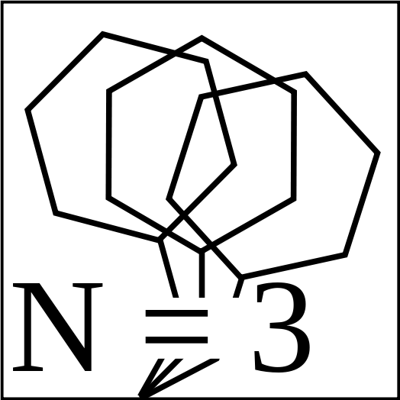
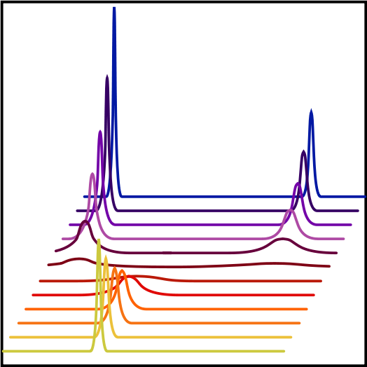

Using relax
To illustrate the capabilities of relax, four subjects will be covered:
1. Field of mathematical modelling.
2. N-state or ensemble analysis.
3. Relaxation dispersion.
4. Frame order.

Slide 9
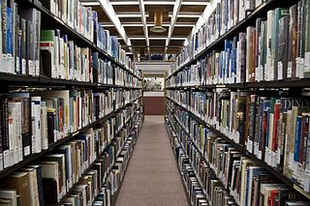
Mathematical modelling and NMR
In NMR, we measure data then interpret:
Direct calculation,
Or model (3D structure, dynamics, etc.).
Field of mathematical modelling – a field much
larger and older than that of NMR.

Slide 10

Model-free analysis
NMR data – relaxation rates R₁, R₂, and NOE (also η_{xy} and η_{z}).
Interpret using Lipari & Szabo model-free theory:
S² – amplitude of motion,
τ_{e} – timescale of motion,
R_{ex} – indicator of slower conformation changes.
Extended to motions on 2 timescales by Clore et al., 1991.
10 model-free models – different combinations of parameters.

Slide 11
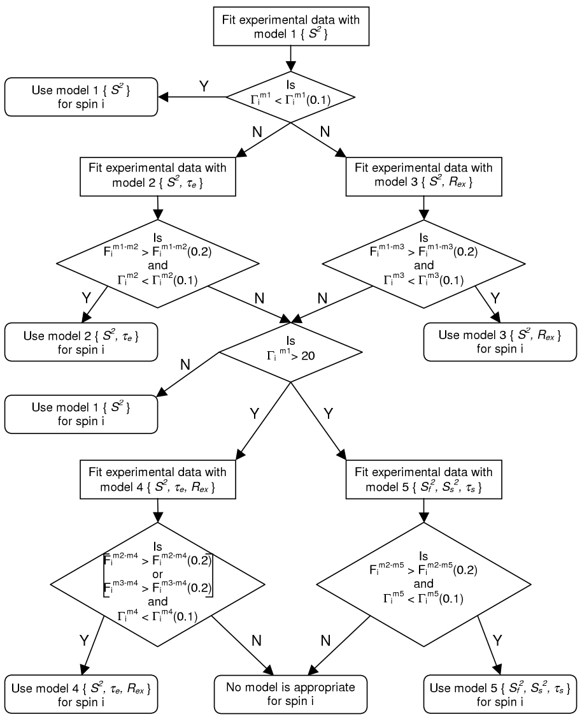
Model-free model selection
Originally: ANOVA or hypothesis testing (χ² and F-tests).
Known for 100 years:
ANOVA up = under-fitting,
ANOVA down = over-fitting.
Hence abandoned by the field!
Hides certain motions because of:
Under-fitting (S² overestimated, τ_{e} and R_{ex} underestimated).
High proportion of data with no model selected.

Slide 12
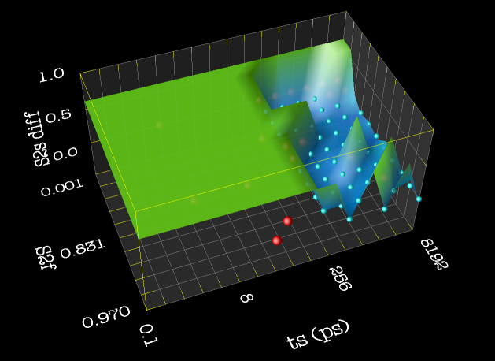
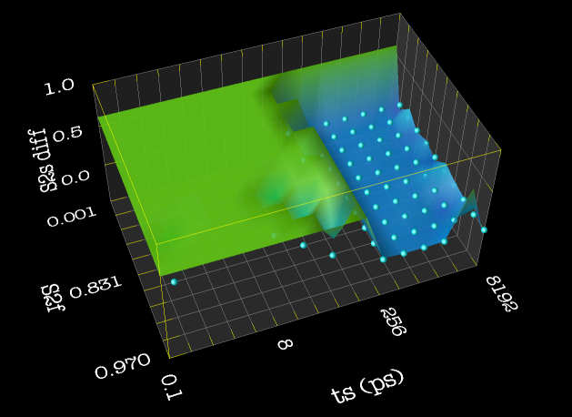
Improving model-free model selection
Model selection is an extensively developed field of mathematical modelling.
3 classes:
Hypothesis testing (ANOVA),
Bayesian methods,
Frequentist methods.
Original
AIC
Akaike's Information Criterion (AIC) - increases accuracy, simplicity, and speed of model-free analysis and removes significant bias.
AIC = χ² + 2k
Notes:
Model selection is an extensively developed field.

Slide 13
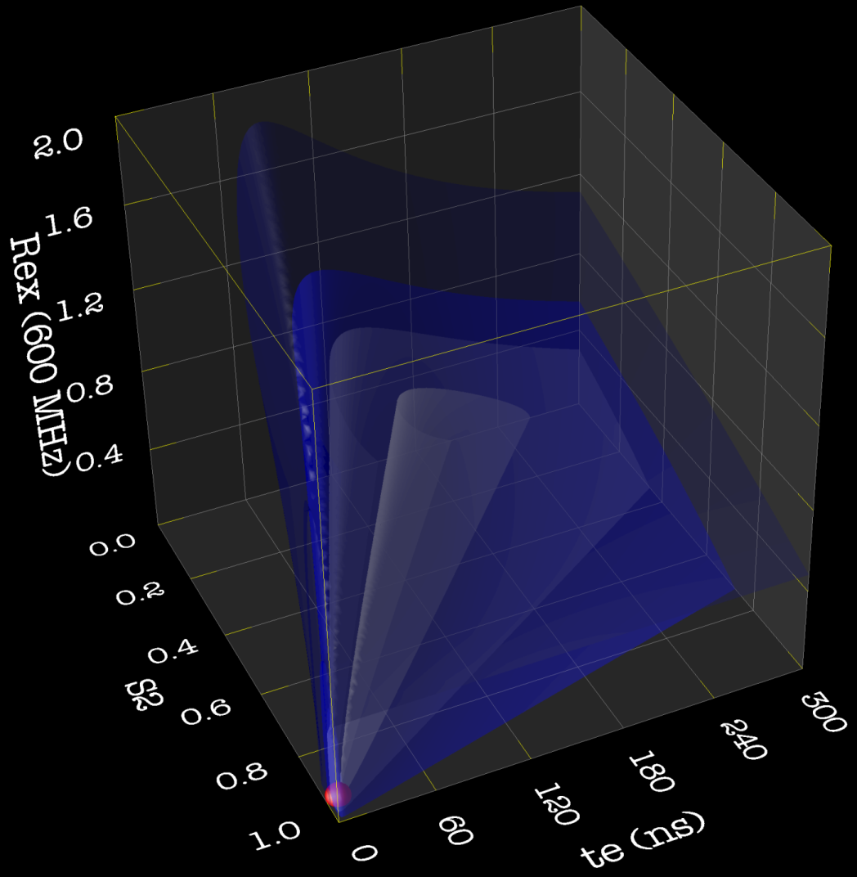
Model-free model elimination
Optimisation sometimes fails,
but no one noticed.
Incorrect model for this data,
but it is selected as the best.
Mathematical modelling – step
called model validation whereby
models can be accepted or rejected.
Empirical rules to eliminate failed models.

Slide 14
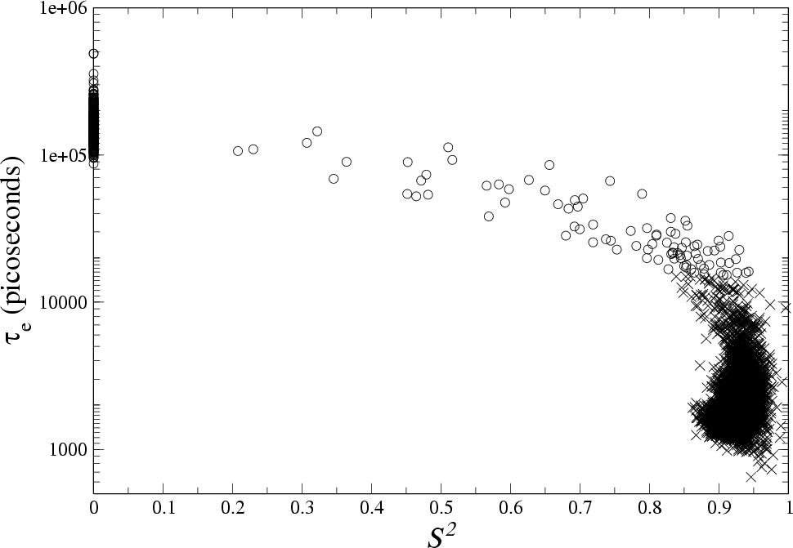
Failure also in Monte Carlo simulations

Slide 15
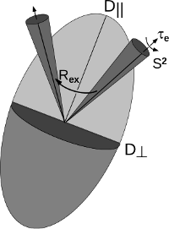
Model-free minimisation
Minimisation:
Modelfree4, Dasha, Tensor2,
Levenberg-Marquardt optimisation.
Four major problems with Modelfree4:
Bug in minimisation code – incorrect results for ~¼ of all data (fixed),
Constraint algorithm – stuck at the limits,
Minimisation finished too early – inaccurate results for 2 timescale motions,
Singular matrix failure of the Levenberg-Marquardt algorithm – no minimisation.

Slide 16
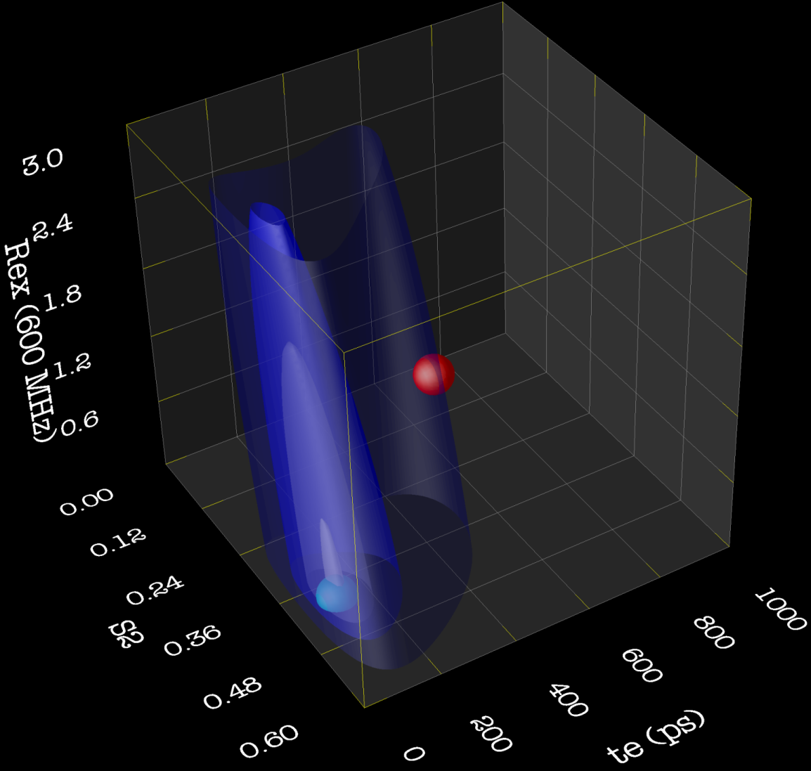
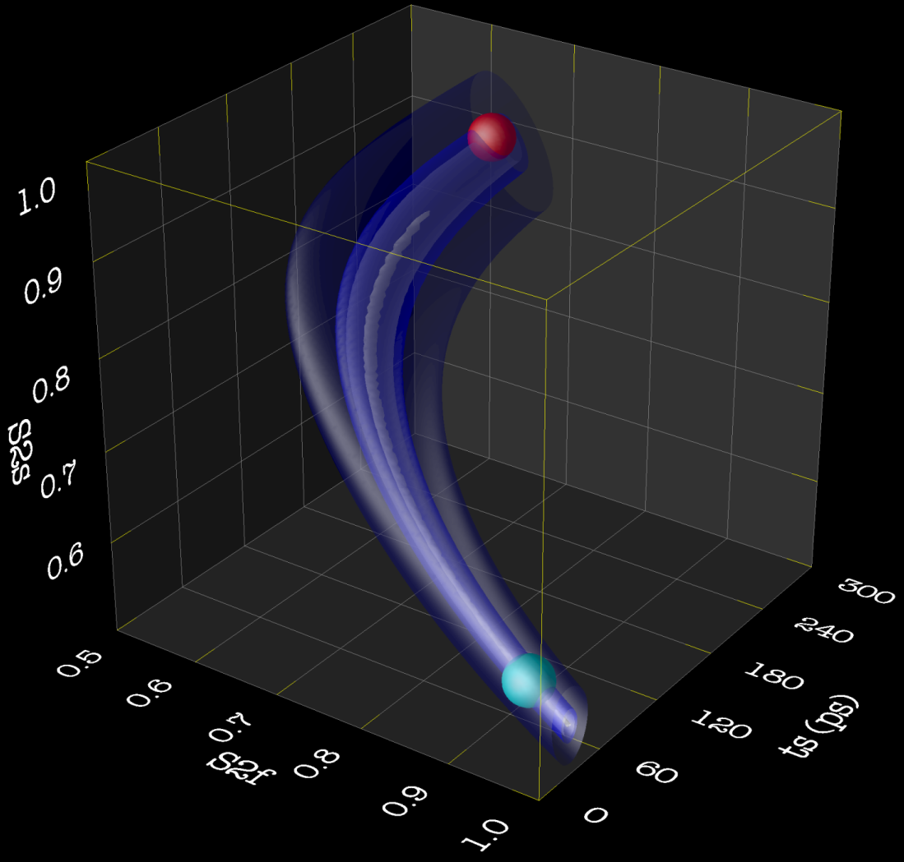
Model-free minimisation - finding the true minimum
Modelfree4 bug
Low accuracy
Should reach the 0 chi-squared value.
~Rosenbrock’s banana function.

Slide 17
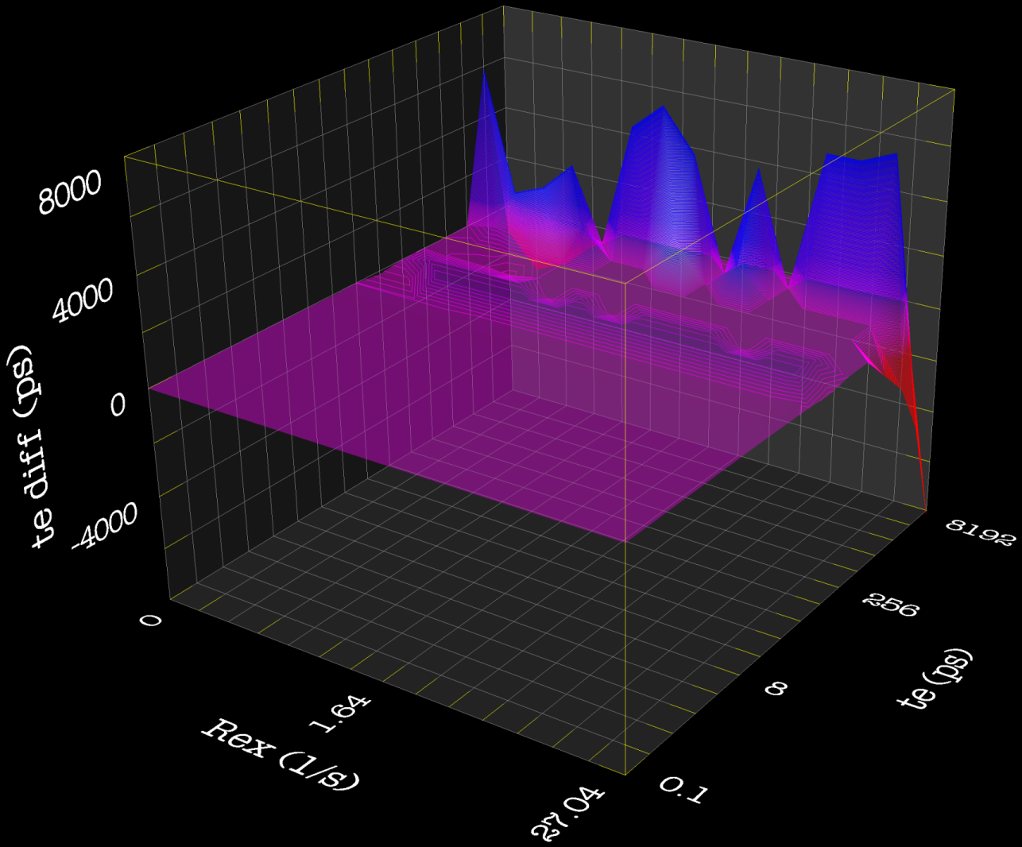
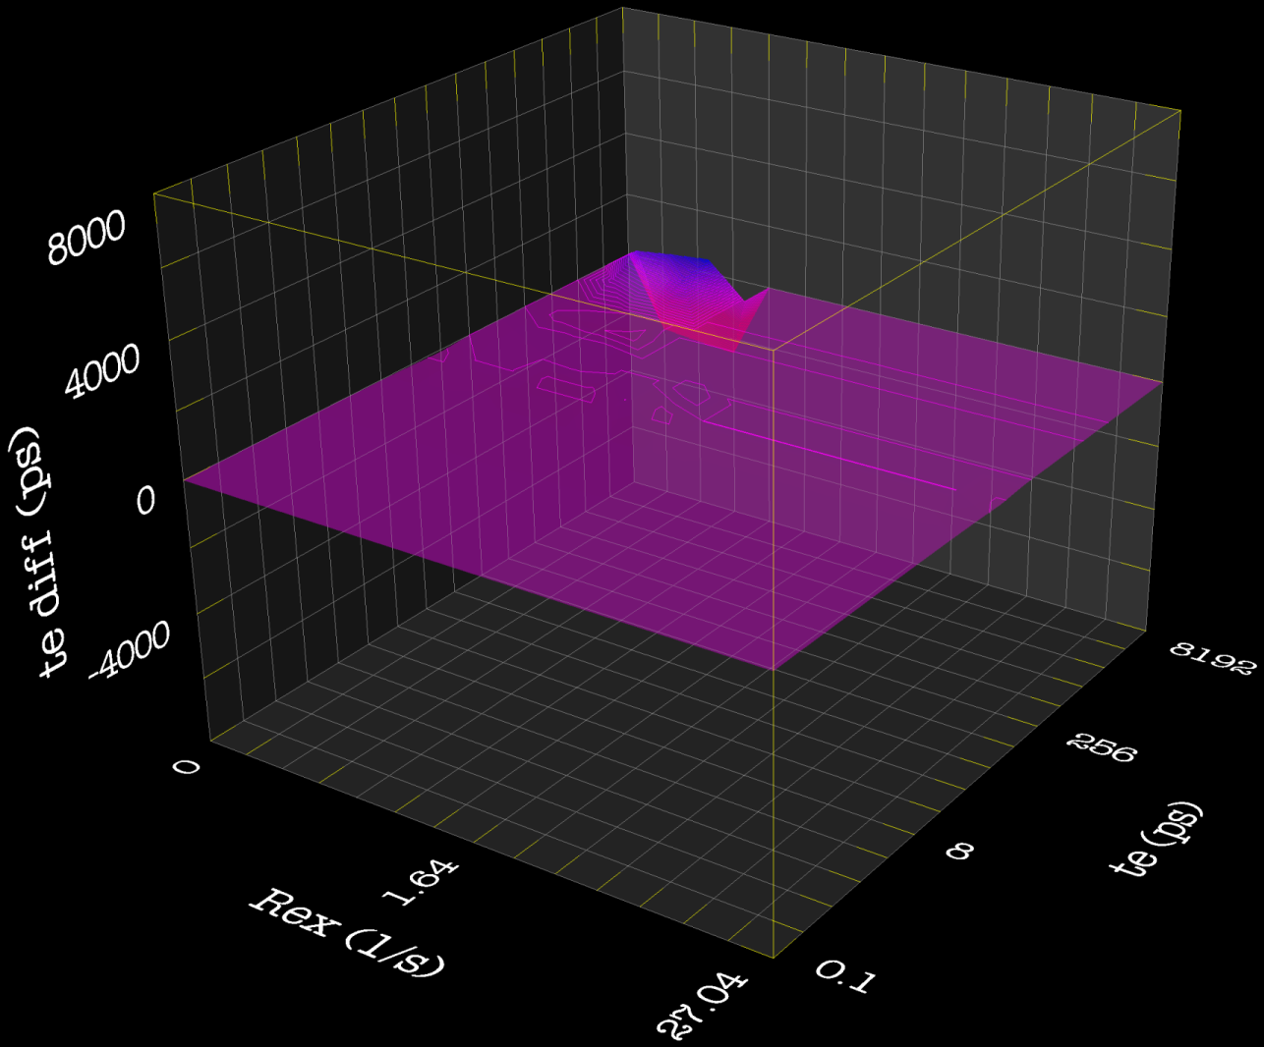
Model-free minimisation – zero difference surfaces test
Modelfree4
relax
relax – Newton optimisation, constrained with Method of Multipliers.

Slide 18
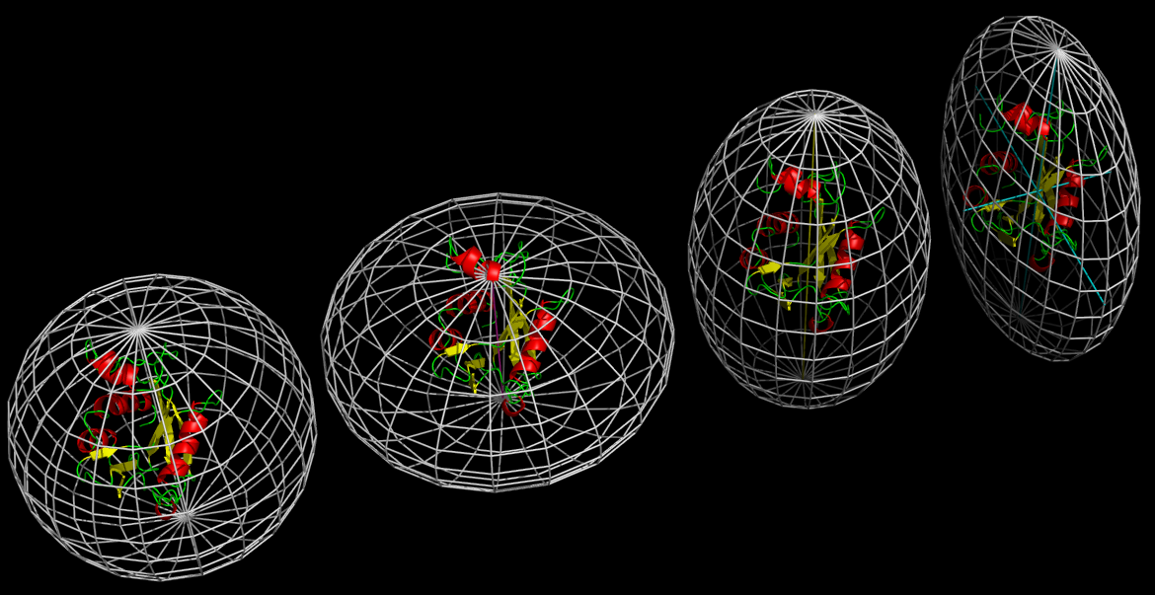

Model-free protocol – chicken and egg problem
F = {S², S_{s}², τ_{e}, τ_{f}, τ_{s}, R_{ex}}
D
What comes first – diffusion tensor or internal motions?
A convoluted problem:
Model-free parameters (F) are dependent on the diffusion tensor (D),
D is dependent on F,
D influences model selection, which in turn influences the optimisation of D.

Slide 19
Model-free protocol – model reformulation
F = {S², S_{s}², τ_{e}, τ_{f}, τ_{s}, R_{ex}}
D
Original protocol – D then F, iterate.
This fails for anisotropic or unfolded systems.
New model-free protocol – F then D, iterate.

Slide 20
Conclusions – Modelling and model-free
Mathematical modelling tools in (or enabled) by relax:
Model selection.
Model optimisation (via minfx).
Model elimination.
Model construction and reformulation.
This allows:
Improved precision and accuracy.
Decrease modelling bias.
Identification of non-obvious failures.
Can be applied to any problem.
Check your maths library before applying mathematical modelling techniques!

Slide 21
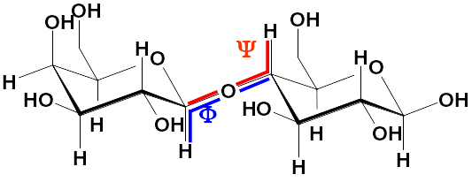
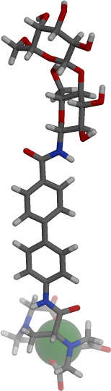
The ensemble or N-state model in relax
How dynamic is the glycosidic bond of sugars?
Galactose
Glucose
RDCs and PCSs
Dy³⁺, Tb³⁺, Tm³⁺, Er³⁺, Yb³⁺, Eu³⁺

Slide 22
Published experimental results – lactose is rigid
NMR structures (RDC)
Jimenez-Barbero et al.,
JACS 2005, 127, 3589.
L2
X-ray structure
Noordick et al.,
Krystallogr. 1984, 168, 59.

Slide 23
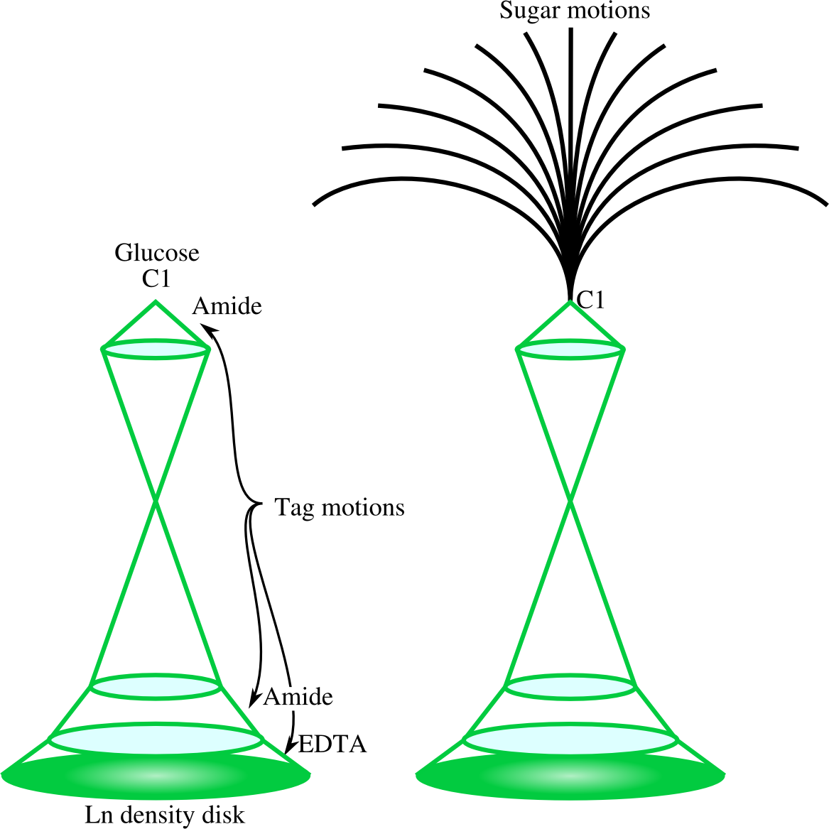
The model in relax
Galactose
Glucose
Amide
Tag
Amide
Ln3+
EDTA

Slide 24
Comparison of conformational models
Selection AIC
Literature (L2) 5366

Slide 25
Comparison of conformational models
Selection AIC
Literature (L2) 5366
L2, L3 only 4381

Slide 26
Comparison of conformational models
Selection AIC
Literature (L2) 5366
L2, L3 only 4381
L1, L4, L5 only 4670

Slide 27
Comparison of conformational models
Selection AIC
Literature (L2) 5366
L2, L3 only 4381
L1, L4, L5 only 4670
All fields 4140
Q_{PCS} ~ 0.219
Q_{RDC} ~ 0.343

Slide 28

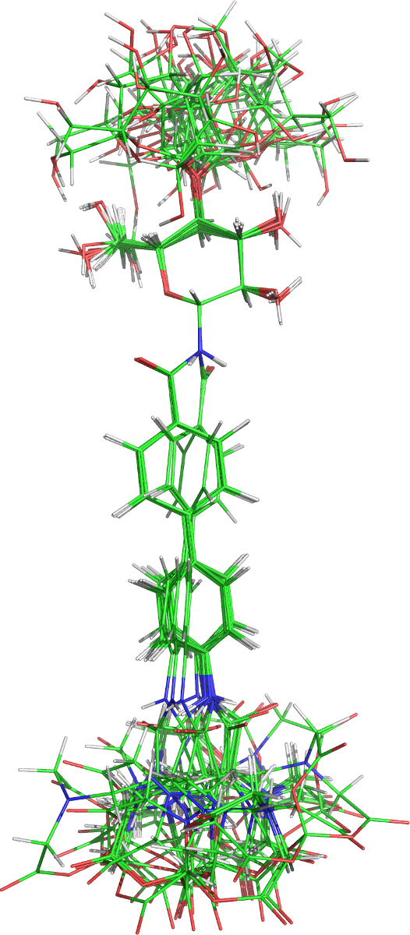
Conclusions – lactose is mobile in solution

Slide 29
Relaxation dispersion

Slide 30
Collaboration in relax
Sébastien Morin (Stéphane Gagné) – added a relaxation dispersion analysis to relax in 2009.
Never completed, but analysis restored and R_{1ρ} data support added.
Troels Linnet (Kaare Teilum) – added CPMG models and features for his NLS analysis.
Paul Schanda, Dominique Marion, & Mathilde Lescanne – donated code for many analytic and dispersion CPMG models.
Nikolai Skrynnikov & Martin Tollinger – donated code developed in Lewis Kay's lab in 2001 (organised by Paul Schanda).
Gary Thompson – wrote the multi-processor code to run on clusters with MPI.

Slide 31
Relaxation dispersion models
Dispersion described by Bloch-McConnell equations.
No mathematical solution → mathematical optimisation of models.
Analytic models – derive equations under specific conditions.
Numeric models – solve the Bloch-McConnell equations numerically.

Slide 32
Analytic models
CPMG-type:
LM63 – Luz and Meiboom (1963) N-site fast exchange models.
CR72 – Carver and Richards (1972) 2-site model for most time scales.
IT99 – Ishima and Torchia (1999) 2-site models for most time scales (p_{A} » p_{B}).
TSMFK01 – Tollinger et al. (2001) 2-site very slow exchange model.
B14 – Baldwin (2014) 2-site exact solution for all time scales.
R_{1ρ}-type:
M61 – Meiboom (1961) 2-site fast exchange model (on-resonance data).
DPL94 – Davis et al. (1994) 2-site fast exchange model (off-resonance).
TP02 – Trott and Palmer (2002) 2-site model for non-fast time scales (off-res).
TP04 – Trott and Palmer (2004) N-site model for all time scales.
MP05 – Miloushev and Palmer (2005) 2-site model for all time scales (off-res).
BK13 – Baldwin and Kay (2013) 2-site model for unequal relaxation rates.
Multi-multiple quantum (MMQ) CPMG-type:
MMQ CR72 – Korzhnev et al. (2004) extension of the CR72 model.

Slide 33
Numeric models
General solutions (no conditions), but orders of magnitude slower and sometimes not well conditioned.
Many more data types possible:
Single quantum (SQ) CPMG-type data.
Zero quantum (ZQ) CPMG-type data.
Double quantum (DQ) CPMG-type data.
Multiple quantum (MQ) CPMG-type data.
Single quantum R_{1ρ}-type data.
Analyse multiple data sets simultaneously (MMQ – multi-multiple quantum).

Slide 34
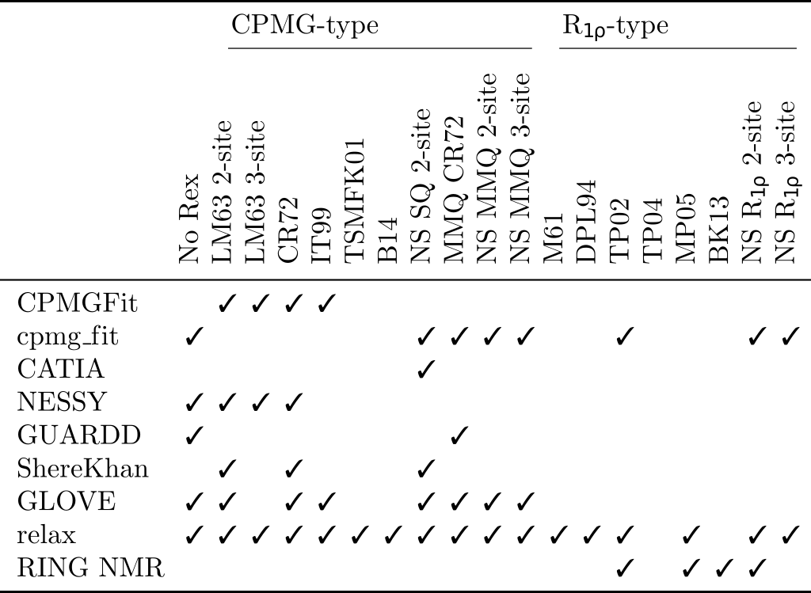
Conclusions – Dispersion software comparison

Slide 35
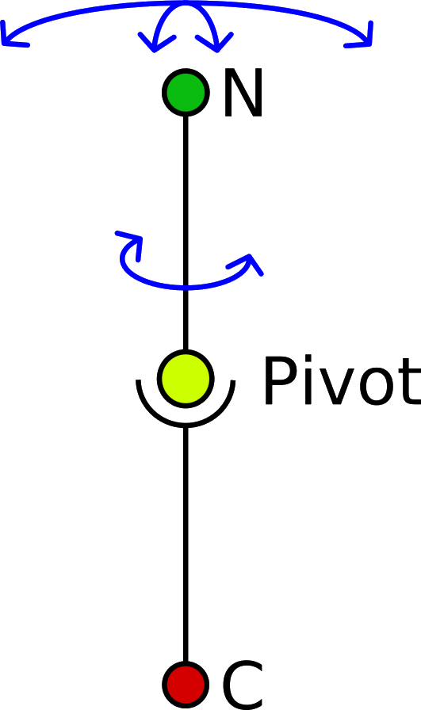
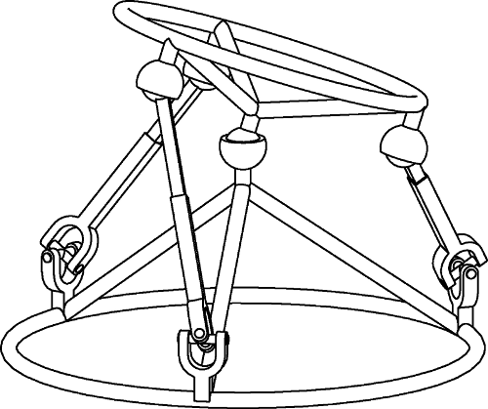
Frame order and domain motions

Slide 36
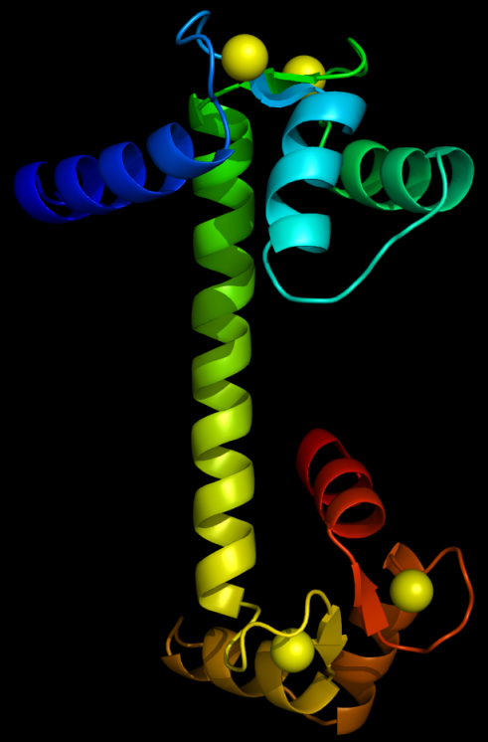
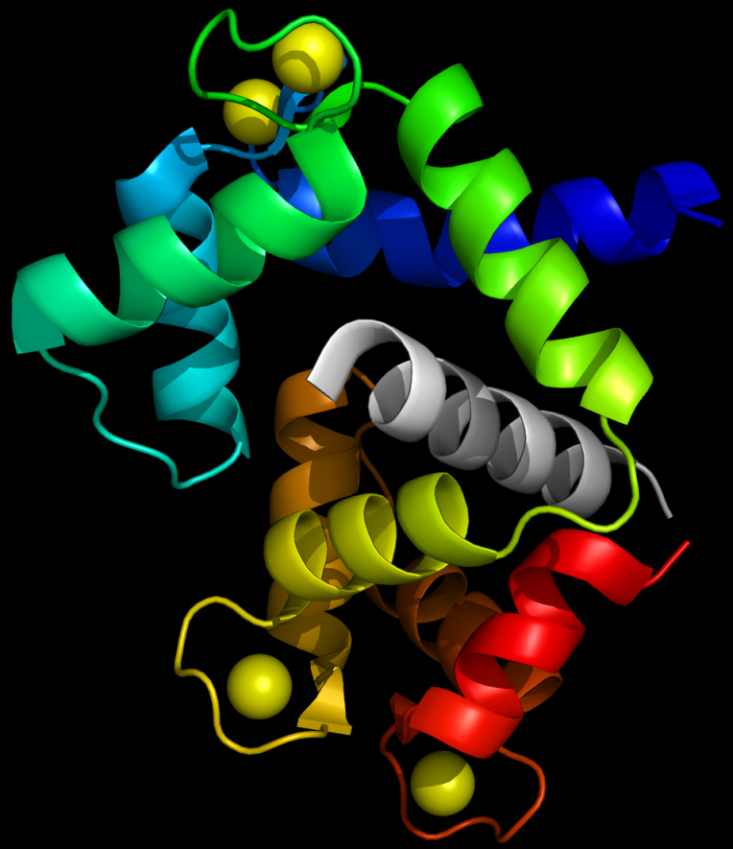
Calmodulin (CaM) – a ball and socket joint
CaM-peptide complex
(2F3Y)
Free CaM
(1OSA)

Slide 37
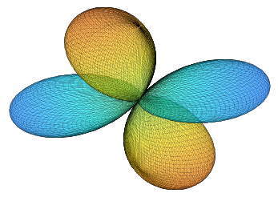
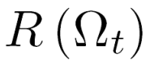
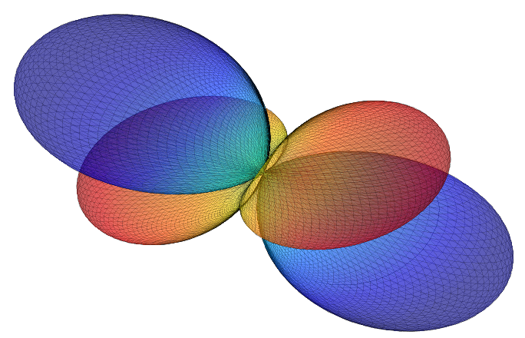
Domain motion and alignment tensor reduction
A
A

Slide 38
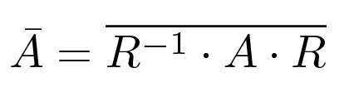
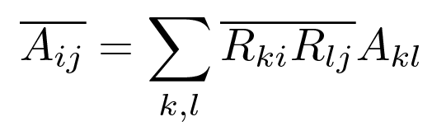
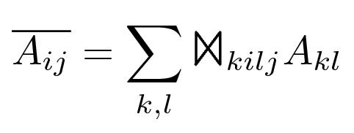
Tensor reduction notations
Underlying physics:
A
Summation notation:
A

Slide 39
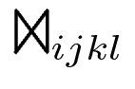
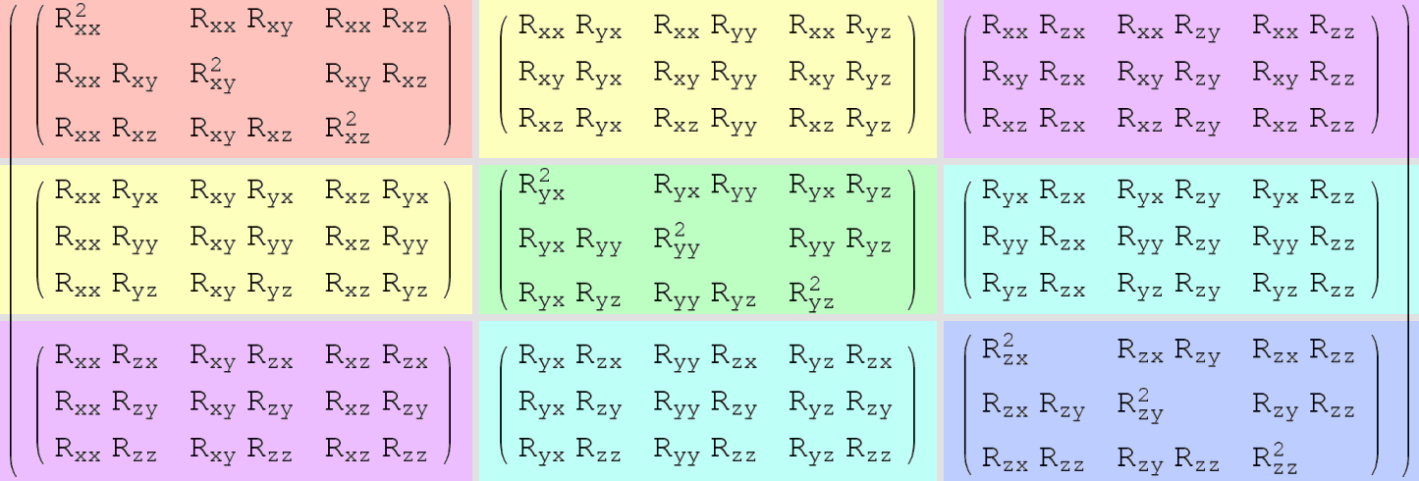
The Frame Order tensor
What is ?
In tensor notation:
Properties:
81 elements.
Order matrix of order matrices.
Describes the ordering of a frame (rank-4).

Slide 40
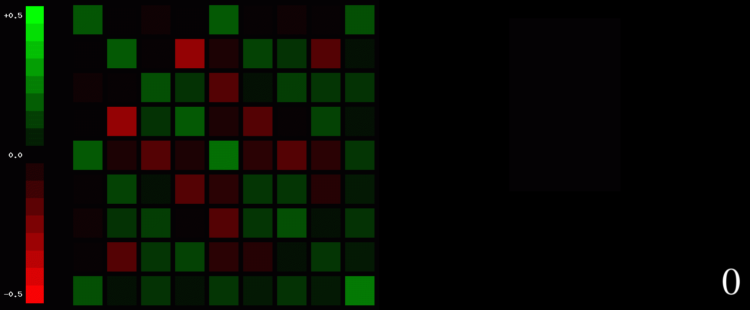
Frame order tensor example

Slide 41
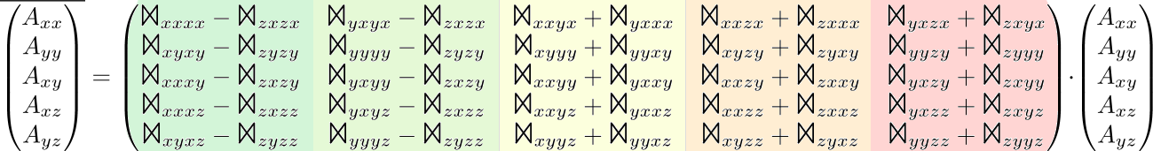
Frame order – the RDC and PCS
In 5D alignment tensor notation:
Collapse 81 → 25 independent elements.
PCS – derivation very complicated, currently intractable. ∴ Solve numerically.
Numerical computation infeasible, so use optimisation tricks (1e⁶ years to 1 day).

Slide 42
Modelling frame order
2 parts – theory and modelling.
Real physics: The frame order matrix.
Modelling: What ever you like!
Tilt-and-torsion angle
system from robotics:
{θ, φ, σ}
Modelling tilt:
Pseudo-ellipse
Isotropic cone
Rigid
Modelling torsion:
Torsional restriction
Free-rotor
Torsionless
Average domain
position
(5-6 params,
rotation + translation)
Directions
of motion
(2-3 params,
Eigenframe)
Amplitude
of motion
(1-3 params,
cone angles or S)

Slide 43
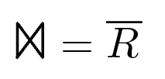
Frame order analysis
Physical theory
Mathematical modelling
How rotational processes modulate NMR interactions.
Any physical model – cone models, jump models, model-free models, ensembles, single structures, etc.
E.g. RDC, PCS, relaxation data.
Map NMR data to highly complex dynamics using analytic or numerical solutions
Applies to all 2nd rank rotational physical processes.
But also applies to all 1st, 2nd, 3rd, 4th, …, ∞^{th} rank physical processes.
Note: Only components of the dynamics present in the frame order tensor can be seen in the NMR data!

Slide 44
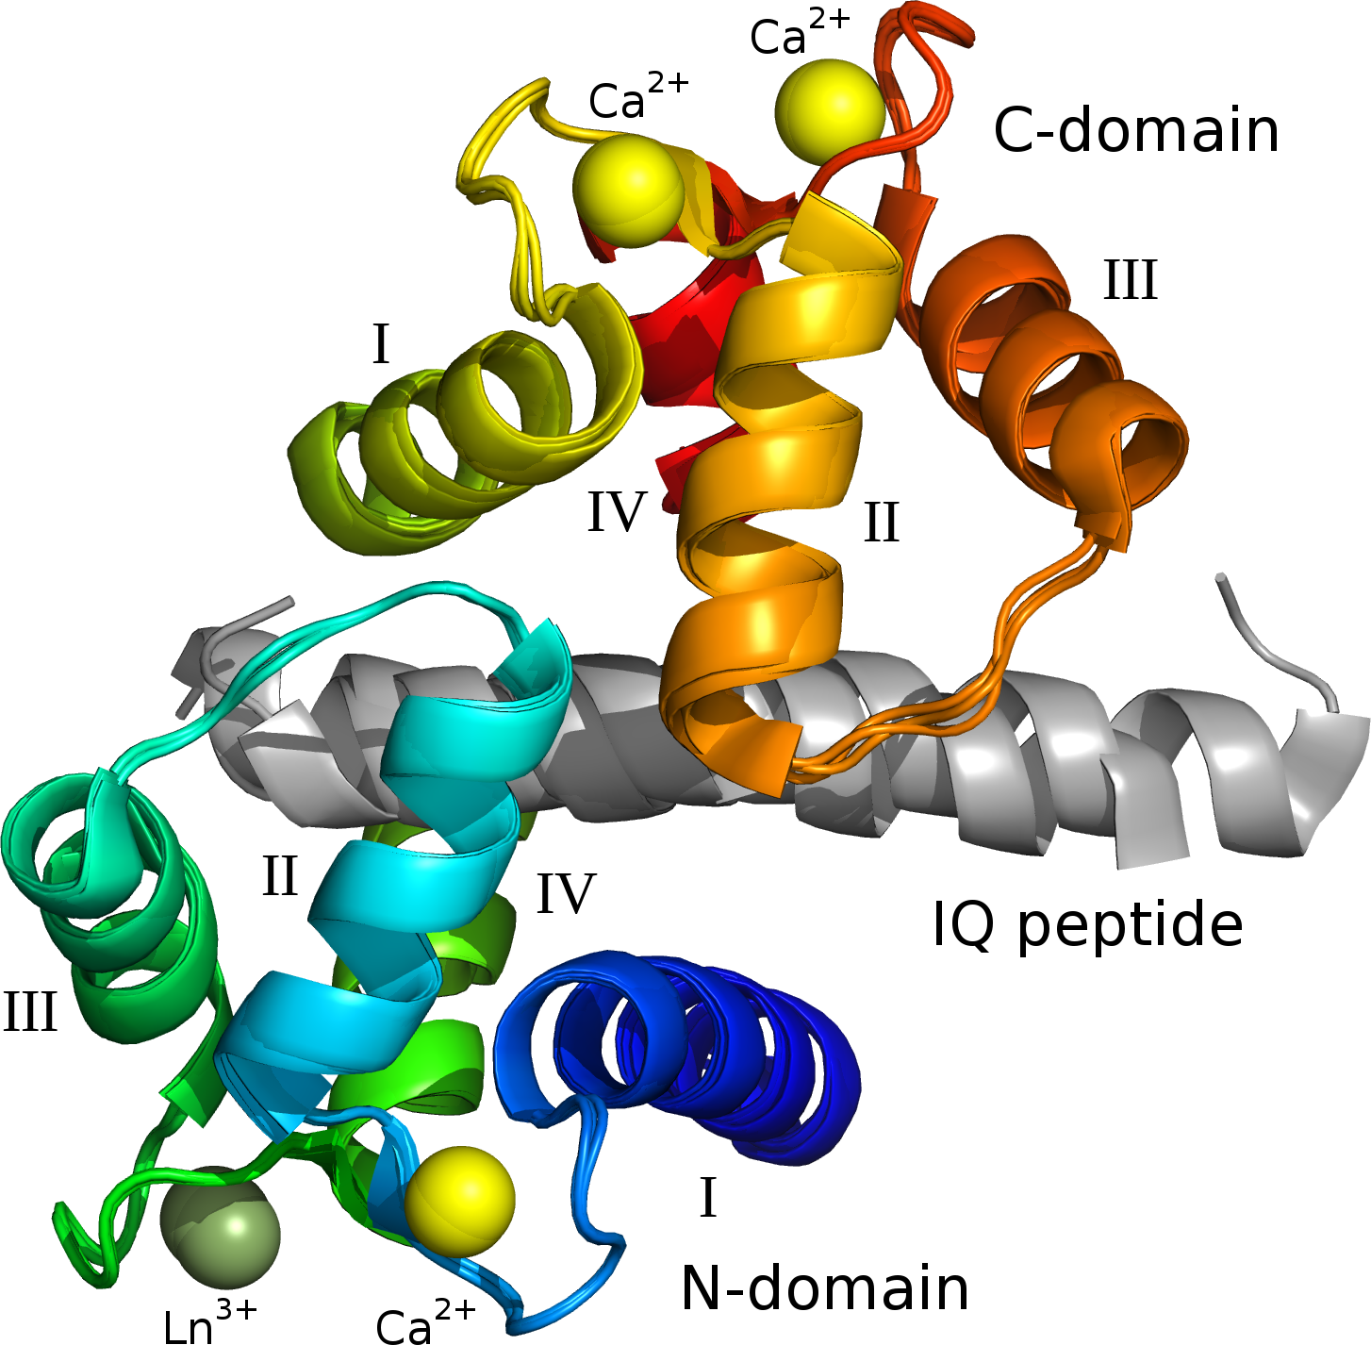
CaM-IQ – X-ray structure as a reference
X-ray has 3 conformations.
Are all motions in the X-ray structure?
Superimposed domains.

Slide 45
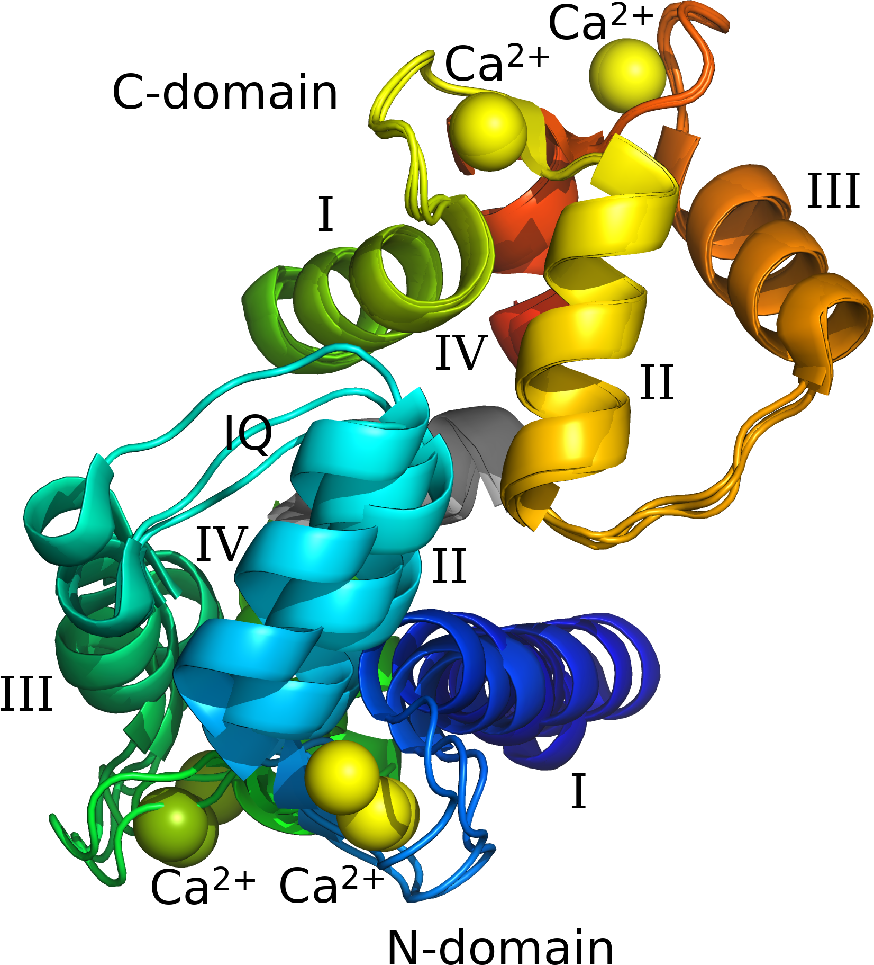
X-ray motions
C-domain superimposition.
To analyse ensemble motion, 3 features added to relax:
1) Web of motion representation:
Link same atom in all 3 structures,
Many triangles (size = amplitude).
2) New algorithm – superimpose with pivot:
Optimisation + Kabsch subalgorithm,
Sequentially remove all motions,
Find major motional modes (~PCA).
3) Interatomic distance and parallax shift fluctuation visualisations.

Slide 46
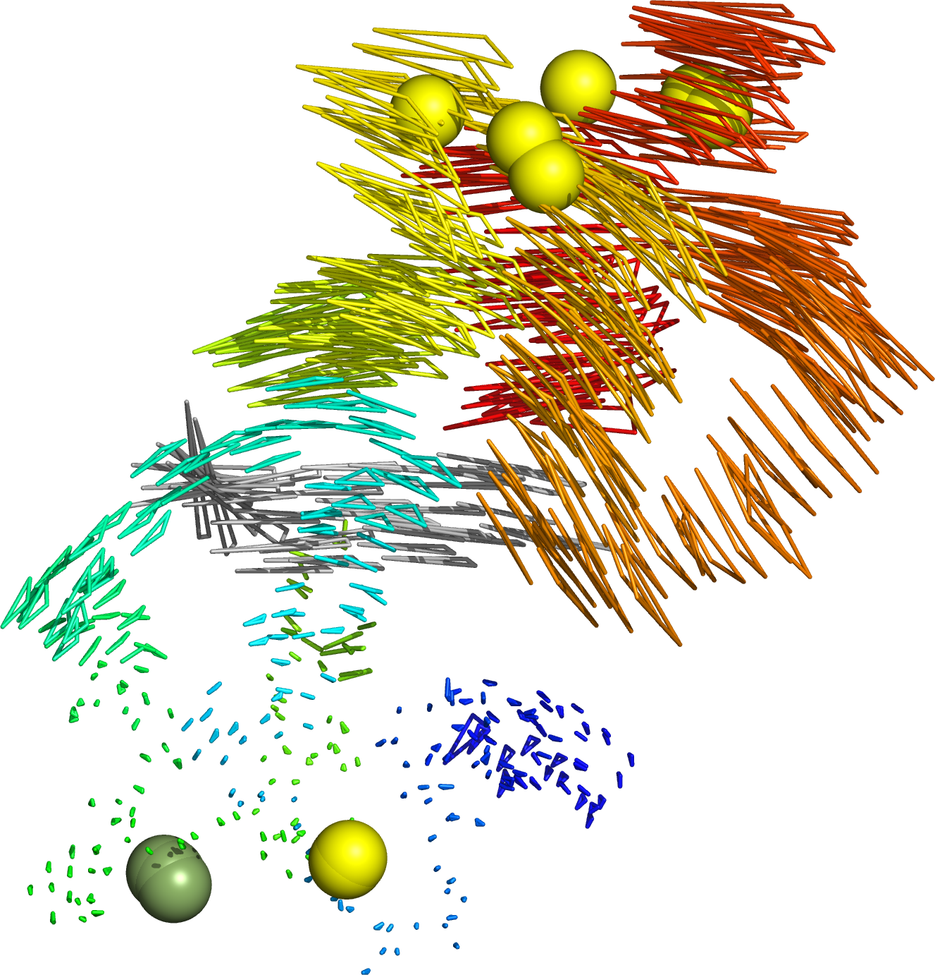
Web of motion
C-domain
N-domain core superimposition.
IQ
N-domain
Representation created by relax, shown in PyMOL.

Slide 47
Web of motion
C-domain
Web of motion and pivot superimposition – two motional modes identified:
Primary: N-domain sliding obliquely over IQ peptide.
Secondary: N-domain rolling along IQ peptide.
IQ
N-domain

Slide 48
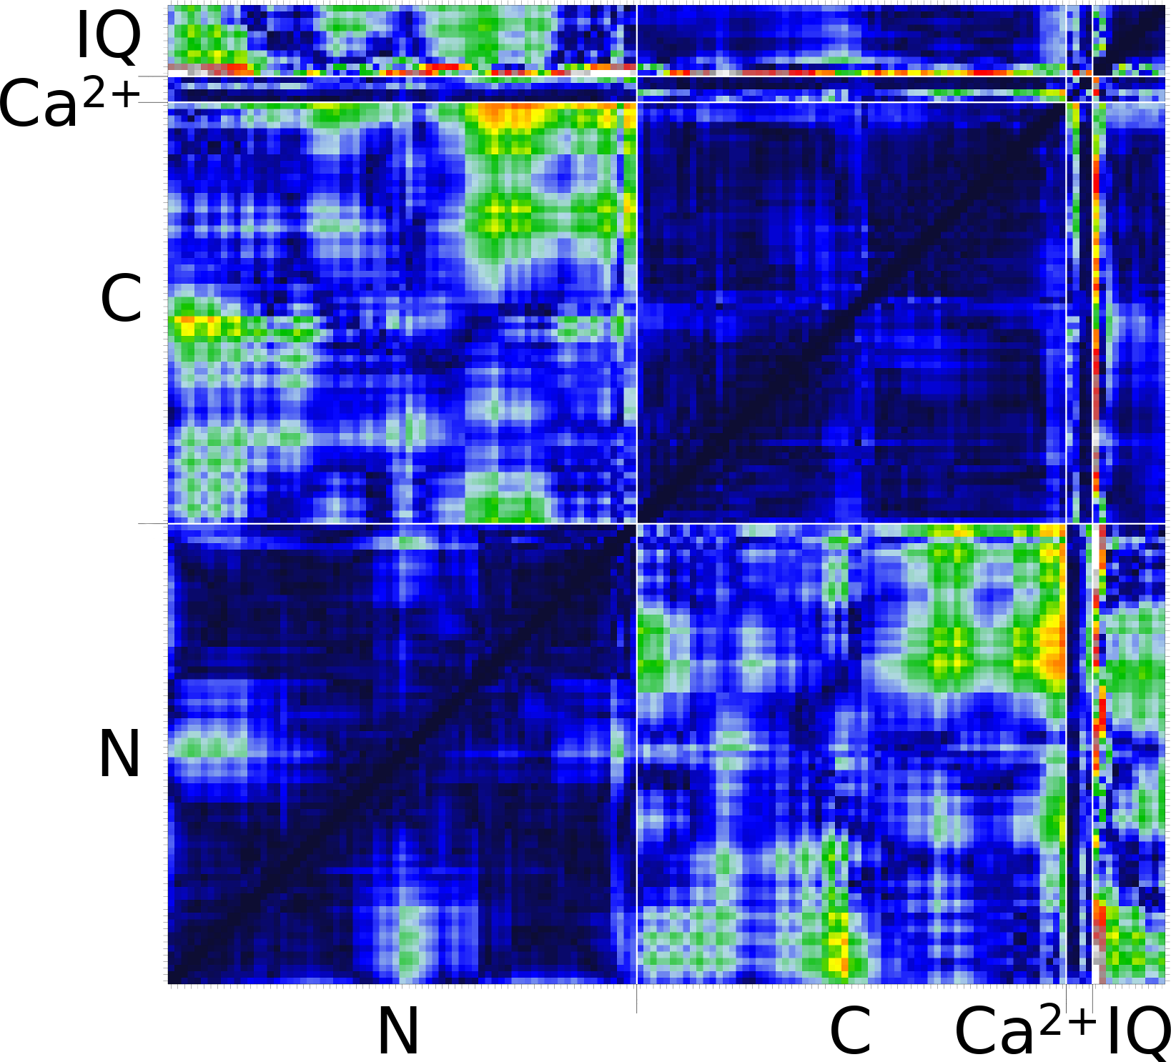
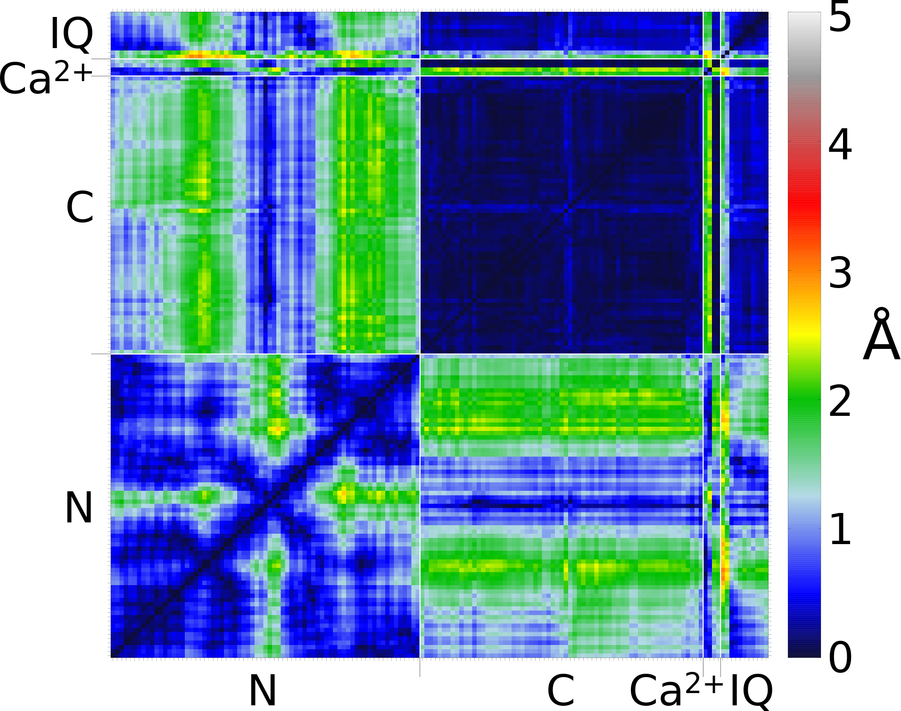


Atomic fluctuations in an ensemble
Interatomic distance fluctuations
Parallax shift fluctuations

Slide 49
X-ray structure is a 3 rigid-body system
C-domain
Three moving rigid-bodies identified:
C-domain + IQ peptide,
Core N-domain,
N-domain helix-II, loop, helix-III.
The motions are correlated.
Is this motion present in solution?
IQ
N-domain

Slide 50
Frame order analysis of CaM-IQ
Break into the three rigid body system:
Core N-domain,
N-domain helix-II, loop, helix-III,
C-domain (no IQ peptide data).
Core N-domain with bound Ln³⁺ set as non-moving reference frame.
Optimise and AIC model selection for the two moving rigid bodies. Results:
C-domain: Pseudo-ellipse.
N-domain helix-II, loop, helix-III: Torsionless pseudo-ellipse.
Steric clashes – only correlated motions are feasible.

Slide 51

Frame order motions of CaM-IQ

Slide 52

Frame order motions of CaM-IQ

Slide 53

Frame order motions of CaM-IQ

Slide 54

Conclusions – CaM-IQ frame order
Frame order ensemble repr.
Frame order eigenmodes
X-ray web of motion
Three rigid body motion is statistically significant.
Large inter and intra-domain correlated motions – not in X-ray or MD ensemble.
Correlated motions = CaM clamp does not open.
IQ peptide can regulate motions, and motions prime deactivation (Ca²⁺ release).

Slide 55
Summary
relax – the most advanced and comprehensive toolkit for processing, analysing, and visualising molecular dynamics using experimental NMR data.
Use the tools for your own analyses: http://www.nmr-relax.com.
Contributions are always welcome.

Slide 56
Acknowledgements
relax developers:
Michael Bieri
Troels Linnet
Chris MacRaild
Sébastien Morin
Andrew Perry
Han Sun
Gary Thompson
Relaxation dispersion:
Martin Blackledge
Christian Griesinger
Sébastien Morin & Stéphane Gagné
Troels Linnet & Kaare Teilum
Mathilde Lescanne & Dominique Marion
Paul Schanda
Martin Tollinger
Nikolai Skrynnikov
Gary Thompson
Model-free improvements:
Paul Gooley
Frame order:
Christian Griesinger
Luigi Russo
Stefan Becker
Benedikt Frank
Christophe Farès
Nicolas Coudevylle
Fernando Rodriguez-Castañeda
Sugar motions:
Christian Griesinger
Máté Erdélyi
‪Armando Navarro-Vázquez
Andrei Leonov

Slide 59

Model-free model selection
Frequentist model selection

Slide 60

Model-free model selection
Frequentist model selection

Slide 61

Model-free model selection
Frequentist model selection

Slide 62

Model-free model selection
Frequentist model selection

Slide 63

Model-free model selection
Frequentist model selection

Slide 64

Model-free model selection
Frequentist model selection

Slide 65

Model-free model selection
Frequentist model selection

Slide 66

Model-free model selection
Frequentist model selection
Criteria – estimates of overall discrepancy. Select the model with the lowest criterion.

Slide 67

A new model-free optimisation protocol
A convoluted problem

Slide 68




A new model-free optimisation protocol
A convoluted problem

Slide 69
Model-free model elimination
τ_{e} too high
τ_{e} , τ_{f} , τ_{s} » τ_{m}
(τ_{x} at upper limit)
True values:
τ_{m} = 10.0 ns
S² = 0.931
τ_{s} = 8192 ps
R_{ex} = 0

Slide 70
Model-free minimisation
The Modelfree bug
Modelfree
S² = 0.263
τ_{e} = 526.32 ps
R_{ex} = 1.053
relax
S² = 0.388
τ_{e} = 128 ps
R_{ex} = 0

Slide 71



Model-free minimisation
The Modelfree bug
Modelfree
S² = 0.263
τ_{e} = 526.32 ps
R_{ex} = 1.053
relax
S² = 0.388
τ_{e} = 128 ps
R_{ex} = 0

Slide 72

Model-free minimisation
Stuck at the limits
Modelfree
S² = 0.947
τ_{e} = 10,000 ps
R_{ex} = 0
relax
S² = 0.970
τ_{e} = 2,048 ps
R_{ex} = 0.149

Slide 73



Model-free minimisation
Stuck at the limits
Modelfree
S² = 0.947
τ_{e} = 10,000 ps
R_{ex} = 0
relax
S² = 0.970
τ_{e} = 2,048 ps
R_{ex} = 0.149

Slide 74
Model-free minimisation
Incomplete minimisation
Modelfree
S_{f}² = 0.622
S_{s}² = 0.893
τ_{s} = 281.74 ps
relax
S_{f}² = 0.952
S_{s}² = 0.582
τ_{s} = 32 ps

Slide 75



Model-free minimisation
Incomplete minimisation
Modelfree
S_{f}² = 0.622
S_{s}² = 0.893
τ_{s} = 281.74 ps
relax
S_{f}² = 0.952
S_{s}² = 0.582
τ_{s} = 32 ps

Slide 76
Model-free model selection
R_{ex} grid - Model count
Selection technique
No model
Model 1
Model 2
Model 3
Model 4
Model 5
AIC
0
8.6
13.5
27.4
49.1
1.5
AICc
0
14.5
19.0
32.9
32.6
1.0
BIC
0
8.0
13.2
27.0
50.2
1.6
Bootstrap
0
5.1
9.0
24.0
57.4
4.6
Cross-validation
0
7.9
11.3
27.6
47.9
5.3
Fixed rules
18.9
4.8
9.4
22.7
43.9
0.3
Hypothesis testing
13.3
16.2
13.7
25.0
31.8
0.1
Overall discrepancy
0
6.6
10.8
27.7
52.3
2.6
The numbers are percentages.

Slide 77

Model-free model elimination
Local τ_{m} too high

Slide 78

Frame order and the PCS
r_{P}
The PCS equation:
r
r_{ln}
Ln³⁺
As a pivoted rotation (Brownian motion):
Ensemble averaged (statistical mechanics):
Far too complicated = intractable! ∴ Solve numerically.
Calculation time longer – tricks used to go from ~1,000,000 years to ~1 day.

Slide 79
Can this be solved for the PCS?
Yes! But need many tricks:
1. Play with numerical integration methods:
Standard quadratic integration (far too slow).
Monte Carlo integration (much faster ~100 times).
Quasi-random (Sobol') integration (~1000 times faster).
2. Parallelisation and running on clusters:
Run multiple calculations simultaneously (100 nodes, 100 times faster).
Not possible – 4 attempts, always slower.
Problem – data transfer speeds between nodes.
3. Start with all RDCs and a PCS subset (~5 spins), optimise, then use all RDC and PCS data (10,000 to 100,000 times speed up).
4. Nested model solutions (up to 6 orders of magnitude).
Calculation time now shorter – from ~1,000,000 years to ~1 day.

Slide 80

PCS error – not just experimental noise
Experimental error of 0.1 ppm.
Is this all? No – structural noise is important!

Slide 81


Model building
Simulate and generate
synthetic RDC+PCS data.

Slide 82




Theory – surface integral for the RDC
x
y
x
y

Slide 83
Theory – surface integral for the RDC
x
y
$$pec\left(θ_{x},θ_{y}\right) → Taylorseries$$
x
y

Slide 84



Theory – surface integral for the RDC
Simulated
Solution

Slide 85


Theory – numerical simulation of the PCS
Generate Sobol’ 3D block.
Convert to 4D uniform sphere using
robotics tilt-and-torsion angles.
Eliminate points outside of the
allowed area.
Rotate coordinates (ave pos), calculate PCS, then average over all points.

